Slide 1
Plant Variety Protection on a European Scale
15 years Community PVP system
Bart Kiewiet, President
Community Plant Variety Office
May 2011

Slide 2
The Community Plant Variety Rights system
Characteristics
Evaluation Community PVP system
Statistics
Surrenders

Slide 3
A system for the protection of plant varieties on
European scale was established by a Regulation of the
European Community in 1994.
Duration of the Community right: 25 years
(30 years for vine, trees and potato varieties).
The Community Plant Variety Office (CPVO) administers the system.
The rights (Community plant variety rights) granted
under this system are valid throughout the territory of
the 27 Member States of the European Union.

Slide 4
The subject matter of a PVR, a plant variety
A variety’ shall be taken to mean a plant grouping within a single botanical taxon of the lowest known rank, which grouping, irrespective of whether the conditions for the grant of a plant variety right are fully met, can be:
  defined by the expression of the characteristics that results from a given genotype or combination of genotypes,
  distinguished from any other plant grouping by the expression of at least one of the said characteristics, and
  considered as a unit with regard to its suitability for being
  propagated unchanged.

Slide 5
What is a plant grouping? Not defined in UPOV convention , but in Reg 2100/94
A plant grouping consists of entire plants or parts of plants as far as such parts are capable of producing entire plants, both referred to hereafter as “variety constituents”.
Variety constituents= propagating material?

Slide 6
Entitlement to protection:
  the breeder: the person who bred or discovered and developed, a variety;
  or his successor in title.

Slide 7
Conditions for granting a plant breeders’ right
Criteria to be satisfied, a variety must be :
NOVEL
DISTINCT
UNIFORM
STABLE
“DUS”

Slide 8
Scope of the right Authorization of breeder required for
Authorization required from breeder for following acts:
Production or reproduction (multiplication)
Conditioning for the purpose of propagation
Offering for sale
Selling or marketing
Exporting
Importing
Stocking for any of the above purposes

Slide 9
Characteristics
Material covered
Variety constituents (propagating material?)
Harvested material, under certain conditions

Slide 10
Harvested material
IF obtained through unauthorized use of
propagating material unless,
reasonable opportunity for breeder
to exercise his right

Slide 11
The right does not extend to
Acts done:
privately and for non-commercial purposes
for experimental purposes
breeding other varieties( breeders’ exemption)
Farm saved seed provision

Slide 12
Advantages of the breeders’ exemption
Germplasm sources remain accessible to the community of breeders
Genetic basis for plant improvement is broadened and is actively conserved
Variety improvement is enhanced
Opportunity for all breeders to share in benefits of breeding activities

Slide 13
Why a specific sui generis IPR for plant varieties?
Most new plant varieties do not qualify for patent protection ( no inventive step)
Under the EPC, plant varieties as such are excluded from paten protection

Slide 14
Evaluation Community pvp system
Summary of key messages

Slide 15
The CPVR acquis functions well and has met its objectives in aggregate. It strikes a reasonable balance between the interests of breeders, growers and consumers. The CPVR acquis incentivizes breeders to invest in research and develop new plant varieties, enabling their exchange for breeding and experimentation.

Slide 16
The breeders‘ exemption is the cornerstone of what makes the CPVR acquis a useful and effective mechanism for protecting plant varieties. The duration of protection is appropriate and the scope of rights is generally effective.
Nonetheless, there are some areas of weakness, particularly pertaining to the agriculture exemption and enforcement opportunities for rights‘ holders.

Slide 17
The evaluation has identified a number of areas in which the system could be improved. For instance, there are links between the Seed Marketing Directives and the CPVR acquis where DUS testing and variety denominations are required for listing and certification, and for plant variety protection. In some cases, these procedures are unnecessarily duplicated.

Slide 18
Looking ahead, the fact that the EU legislative framework for patents allows for dual protection of patents and plant variety rights is a major concern, particularly as patents become more prevalent in agricultural research. This is due to the lack of a breeders‘ exemption and limited research exemption for patents.
Determining whether a plant variety may overlap with a patent can be difficult without sufficient legal and technical expertise. CPVO could provide more information regarding plant-related patents and their implications for particular plant varieties.

Slide 19
There are no standardized protocols or thresholds to determine essentially derived varieties (EDVs), making disagreements more difficult to resolve.
CPVO could play a greater role in assisting industry develop standardized approaches to determining EDVs for the most economically important species.

Slide 20
Statistics
YEAR 2010

Slide 25
Trends in surrenders

Slide 26
Approach
Analysis by crop
Graph showing cumulative % surrendered over years n, n+1…
One line per year title granted
1996 runs to n+15 (2011)

Slide 27
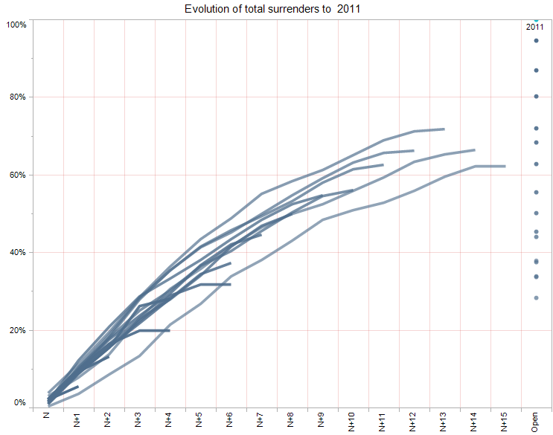
All crops: evolution of surrenders

Slide 28
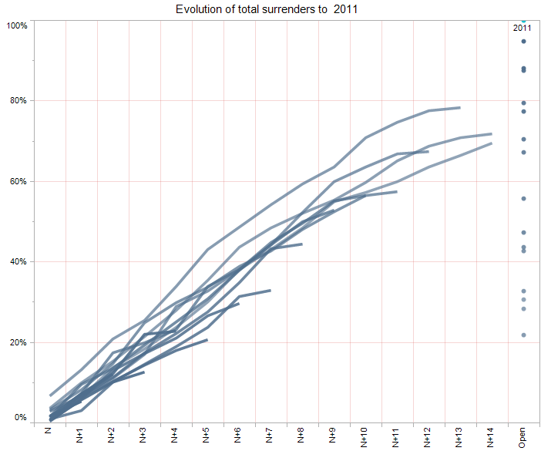
Agriculture: evolution of surrenders

Slide 29
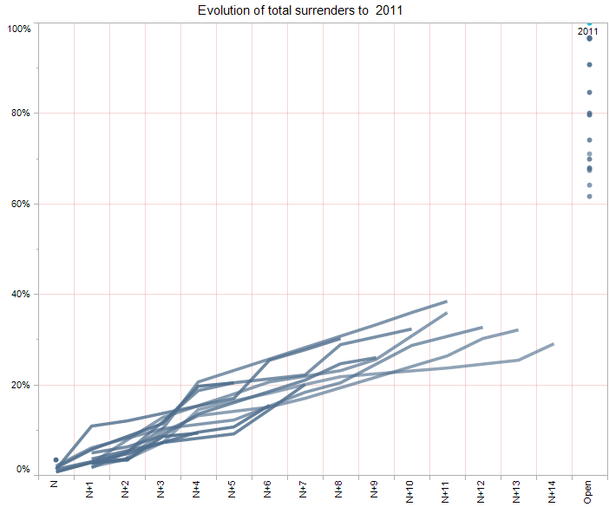
Fruit: evolution of surrenders

Slide 30
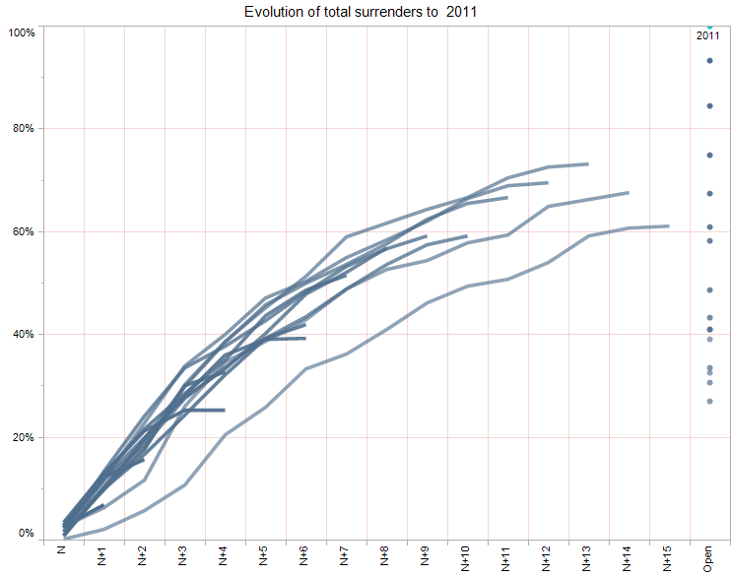
Ornamental: evolution of surrenders

Slide 31
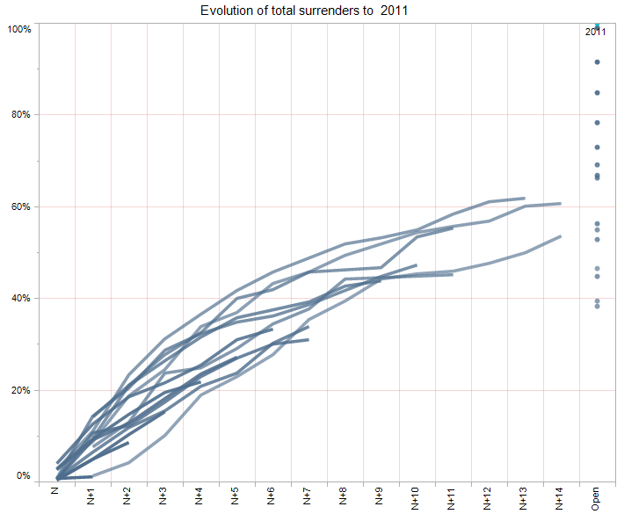
Vegetable: evolution of surrenders

Slide 32
Conclusions
Surrenders consistent within each crop sector
Fruit has lowest surrenders - 29% of 1996 titles surrendered by 2011
Agriculture has highest surrenders - 69% of 1996 titles surrendered by 2011

Slide 33
THANK YOU
FOR YOUR ATTENTION

Slide 34
Essentially Derived Varieties
Jaap N. Kras
1

Slide 35
A mature industry like agriculture deserves a mature breeder’s right
Clear texts simple treaty, EU regulation and law
        2

Slide 36
EDV
the EDV rules are not totally understandable
they restrict the breeder’s exemption
whereas we have to join all agriculture forces to keep the breeder’s exemption against the patent system of dependency
3

Slide 37
Goal
Goal: the general goal of an intellectual property right is to stimulate innovation
in the general interest of society
breeder’s right wants to stimulate breeding
4

Slide 38
Tool
The tool is a prohibition right
All intellectual property rights are prohibition rights
The PBR holder / owner is given the right to forbid others to trade propagation material of his variety
5

Slide 39
Breeder’s right is not written to grant a breeder an opportunity to raise an income
every entrepreneur, also a baker, butcher, grocery propagator and grower, even a consultant has a right to earn a fair income.
(see Dutch constitution art.1)
6

Slide 40
Why we do have a breeder’s right?
why do we have a breeder’s right and not an exclusive right for bakers, butchers, groceries although their functions are also very important?
it is in the interest of society that we stimulate breeding (inventing, writing, composing etc.)
7

Slide 41
General interest
the words general interest in breeder’s right and patent law mean the interests of all of us: breeders, propagators, growers, traders and consumers
(they do not specifically point to famine or war situations)
8

Slide 42
A breeder can give permission to trade, grow etc. propagating material of his variety under certain conditions
9

Slide 43
exclusive right under conditions
the exclusivity right is given under certain conditions:
limited in time and region
research exemption
breeder’s exemption
hobbyist exemption
“new” means also give up your exclusive idea
10

Slide 44
Rights are further limited by the general interest
a PBR owner is not allowed to use his breeder’s right to set unlimited conditions
other rules (intl. property rights) have to be respected (the non competition rules,
phytorules, CITES etc)
general interest (ZPW art 61,1 61,2 and 62)
11

Slide 45
character of a breeder’s right
the character of intellectual property rights is that they are
absolute rights (every body has to respect them)
abstract rights: you can not smell, feel, touch see or hear them
they are rights to a thought, to a creation of the mind
12

Slide 46
law principle
every act in law needs to have a clearly defined subject.
no subject? No act in law
so a breeder’s right starts at the moment you do the abstract creation: the moment the idea occurs, not earlier and not later
13

Slide 47
Start of a breeder’s right
the person who has the thought, the idea, is the only one allowed (has the exclusive absolute right) to apply for a breeder’s right.
this is a difference with patent right where the moment of first application is decisive
14

Slide 48
How does a breeder’s right arise?
EU PBR regulation art. 12 formulates correctly:
Entitlement to file an application for a Community plant variety right :
‘allowed is any natural or legal person’
15

Slide 49
If you are a natural or legal person and fulfil the demands you can apply for a breeder’s right
16

Slide 50
Essentially derived variety regulation
what is an essentially derived variety (EDV)?
nobody knows but I think the idea was to strengthen the position of existing breeders against those who came up with a mutant or slightly different variety and were granted (under the ’78 act) an independent breeder’s right
17

Slide 51
shot in the foot
the breeder’s associations gathered at the UPOV meeting for the convention of 1991 wanted to strenghten their own position (greedy) against newcomers and used
the mutant argument to close the door for newcomers
18

Slide 52
EDV
the EDV regulation gives the original breeder the right to claim that a new variety is an EDV and therefore also the permission of the initial PBR holder is needed to bring it to the market
19

Slide 53
EDV
some authors write that, with an EDV, the breeder of the initial variety should have the opportunity to earn money from the EDV: an extra source of income for the original breeder
(earlier I gave you my opinion on that income aspect)
20

Slide 54
reasons for an EDV
to prevent too easy copying of a new variety by bringing in only a slight small difference and ride further free on the work of the original breeder
to have an opportunity to bring mutants under the control of the initial breeder
to force patent owners to ask the breeder for permission if the only thing they do is bringing in a patented gene into a variety
21

Slide 55
EDV in art. 14,5 UPOV
5. [Essentially derived and certain other varieties]
a. The provisions of paragraph 1 tot 4 shall also apply in relation to
i. varieties which are essentially derived from the protected variety, where the protected variety is not itself an essentially derived variety
ii. varieties which are not clearly distinguisuishable in accordance with Article 7 from the protected variety
-5 {Essentially derived and certain other varieties]
iii. Varieties whose production requires the repeated use of the protected variety
b. For the purpose of sub-paragraph a i a variety shall be deemed to be essentially derived from another variety (‘the initial variety’) when
i. it is predominantly derived from the inittial variety, or from a variety that is itself predominantly derived from the initial variety, while retaining the expression of the essential characteristics that result from the genotyp or combination of genotypes of the initial variety.
ii. It is clearly distinguishable from the initial variety
and
iii. Except for the differencs which result from the act of derivation, it conforms to the initial variety in the expression of the essential characteristics that result from the genotype or combination of genotypes of the initial variety
c. Essentially derived varieties may be obtained for example by the selection of a natural or induced mutant, or of a somaclonal variiant, the selection of a variant individual form plants of the initial variety, backcrossing, or transformation by genetic engineering.
        22

Slide 56
Who understands this?
The Secretary General of the UPOV was asked at the last day of the conference in 1991 to come up with concept guidelines to give concrete form to this article
you understand we are 20 years further and… 23

Slide 57
Did the first 20 years EDV bring what was wanted?
did it in any way solve the mutant problem?
  No, it doubled the mutant problem
  24

Slide 58
EDV doubles the mutant questions
first we have the question at the application
second we have the question is it an EDV or not
25

Slide 59
EDV further disavantages
breeder’s right is meant to stimulate breeding EDV does the opposite so infringes on the character of breeder’s right.
it is never in the interest of the initial breeder to give permission to an EDV
it is always against his commercial interests.
26

Slide 60
disavantages of EDV
in some cases it can be necessary out of (general interest) to grant a variety that slightly differs an independent breeder’s right: when the new variety is an enormous step forward (black tulip, blue rose, phytophthera-resistant potato )
27

Slide 61
impossible burden for the initial breeder
the claim on EDV has to be executed by an original PBR owner: he has to prove that a variety is an EDV
the suggestion to turn the position by giving the task to the EDV holder to prove his new variety is not an EDV is wisely turned down.
28

Slide 62
Did the EDV strengthen the breeder’s position against an inventor’s patent?
no
29

Slide 63
Disadvantages of EDV
what did we learn from the few cases we had: procedures in court are very expensive, very complicated and take a long time;
high costs with only losers in the end
the breeder’s weakened voluntarily the breeder’s exemption by bringing this EDV regulation in the treaty
30

Slide 64
Let us go back to the situation before ‘91
let us formulate the most important characteristics per crop
and let us accept that:
the controller decides at the application whether we have a new variety or not
31

Slide 65
indeed
if the controllers widen the distances between varieties, and we can let that depend on the crop, we prevent too many mutants
32

Slide 66
Red head
sometimes persons are very angry on me while saying this (not only breeders but even persons who are sitting in court and breeder’s right council) as if I made these rules
or they say how many cases did we have after all these years? Happily only a few.
or the problem is not as big as expected, or most cases are dealt with mutually, or the EDV rules are too uncertain for court cases
33

Slide 67
Breeder’s exemption
change UPOV and take the EDV out
we can also use the opportunity to improve some other misunderstandings as the presumption ‘breeding’, the meaning of the words general interest.
34

Slide 68
Ham and eggs
The little hen proudly walked around the farm and met a huge swine lying in the sun in the mud.
Good morning mr. Hog he said, did you hear the farmer this morning? We should cooperate.
Well said the swine arrogantly looking down on the little hen, did you come all the way here to tell me this nonsense? He laughed and crawled deeper in the mud.
Well the little hen said we even have to merge I understood, the swine didn’t answer and laughed louder. Yes added the hen, ‘ham and eggs’ are the most popular breakfeast in the world,
Than the swine fell silent and whispered ‘yes but you lay a fresh egg every morning’
35

Slide 69



Slide 70
Practical implementation of
Plant Breeders’ Rights in countries with an emerging PVP system
ArndJan van Wijk

Slide 71
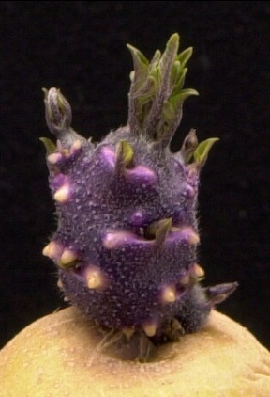
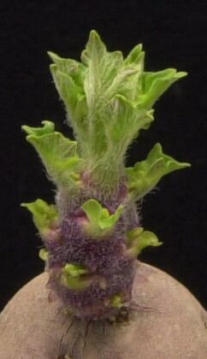
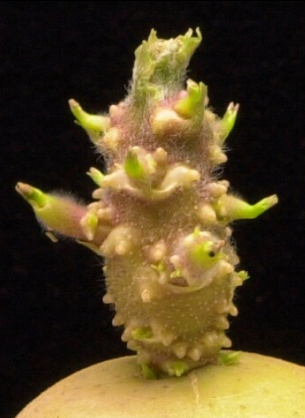
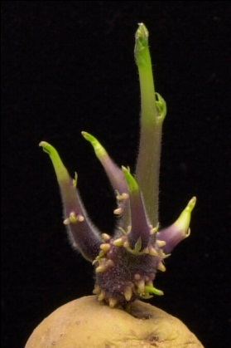
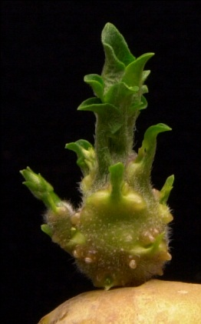
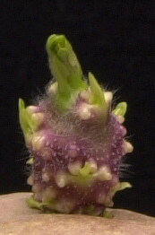
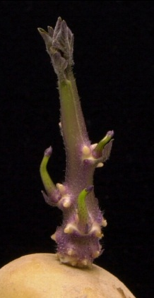
Contents
Introduction
Introducing a Plant Variety Protection system
Practical implementation
Constraints in DUS testing
Concluding remarks

Slide 72
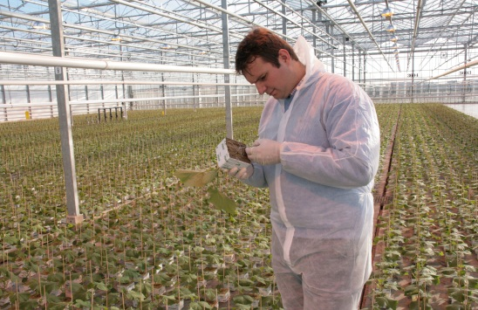
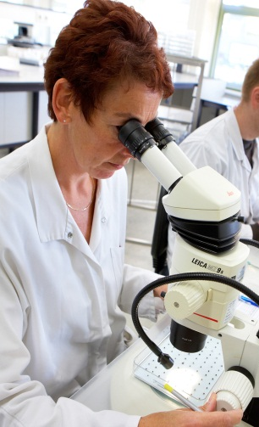
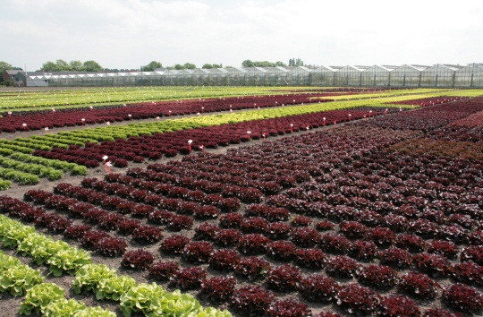
Naktuinbouw – statutory duties
Basic inspection of horticultural propagating material according to
  Dutch Seeds and Plant Material Act and Plant Disease Act
  European legislation
DUS testing for listing and Plant Breeders’ Rights
  Agricultural crops
  Ornamental crops
  Vegetable crops

Slide 73
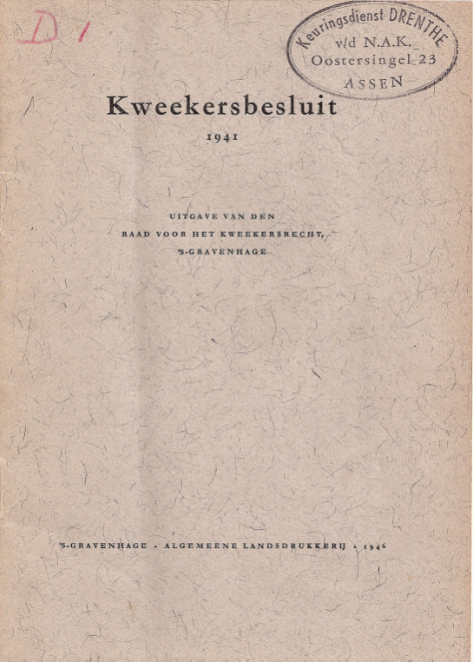
Other task - Knowledge transfer
Long and wide experience on Plant Breeders’ Rights available in the Netherlands
Naktuinbouw is willing to share this expertise
  Through projects mainly financed by NL EVD International and receiving country
In interest of
  Receiving country
  Breeding industry in the Netherlands and foreign country

Slide 74
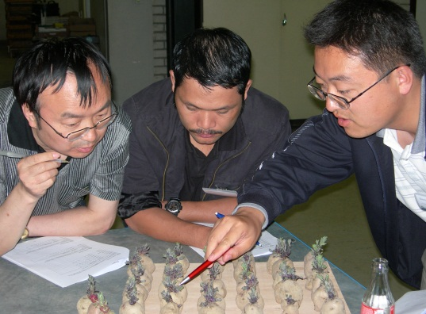
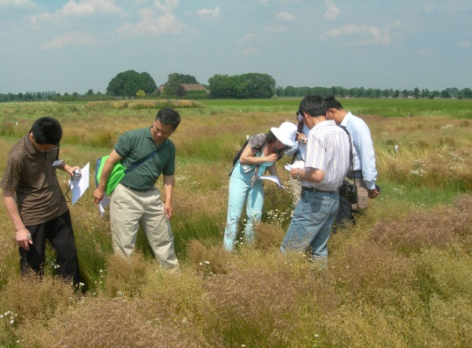
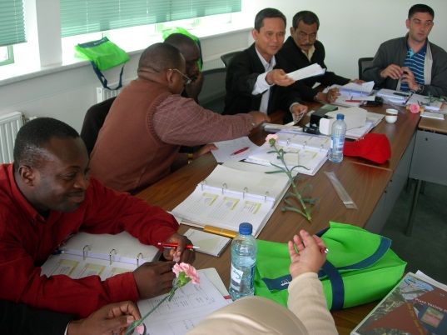
Knowledge transfer in five steps
UPOV Distance Learning Course
Naktuinbouw PVP course
Bilateral projects between Naktuinbouw and national PVP systems
Internships at Naktuinbouw
Naktuinbouw Help Desk

Slide 75
Contents
Introduction
Introducing a Plant Variety Protection system
Practical implementation
Constraints in DUS testing
Concluding remarks

Slide 76


Why introducing Plant Breeders’ Rights?
Obligation of members of World Trade Organisation to implement TRIPs Agreement
Article 27 (3) b
  …… to provide protection for plant varieties by patent or an effective sui generis system, or a combination thereof
As a consequence, many countries ventured into development of PVP system during past ten years

Slide 77

Development of PVP system
First step - Development of legal basis
  Relatively easy – many examples
Second step – Practical implementation
  Secondary legislation (ministerial decrees, government regulations etc)
  Institutional, technical and financial arrangements
Very often
  Emphasis on legislation and not on practical implementation
  PVP system has far reaching institutional, technical, financial and commercial consequences
Good practical implementation of a PVP law is as or even more important as developing the law itself

Slide 78
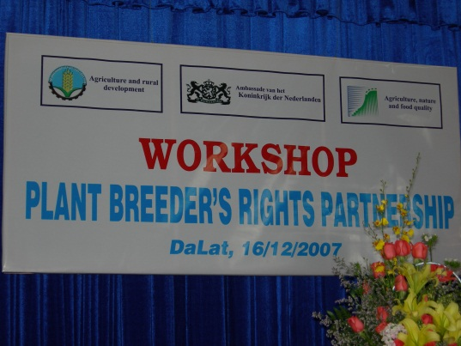
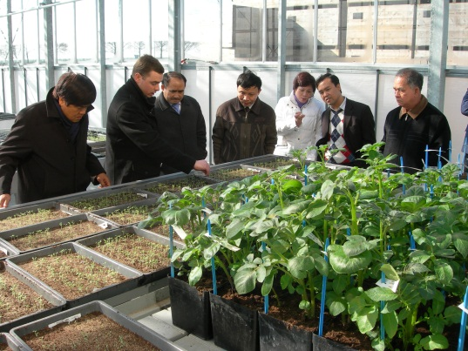
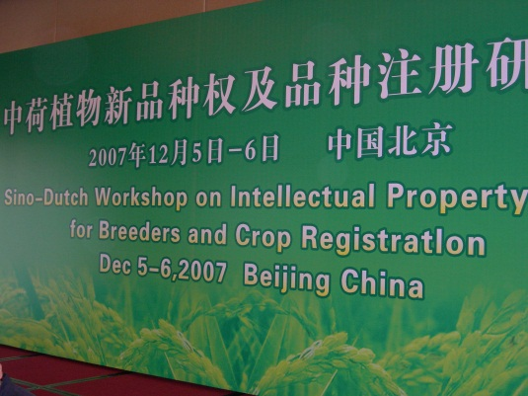
Legal matters
Non - UPOV countries and UPOV 1978 countries: law not to liking of breeders
  Farm saved seed
  Scope of protection
  Number of genera and species to be protected
Hard to influence changes
Approach
  Showing benefits of PVP system in the Netherlands by study visits to NL
  Organising seminars on benefits of sound PVP system

Slide 79
Contents
Introduction
Introducing a Plant Variety Protection system
Practical implementation
Constraints in DUS testing
Concluding remarks

Slide 80
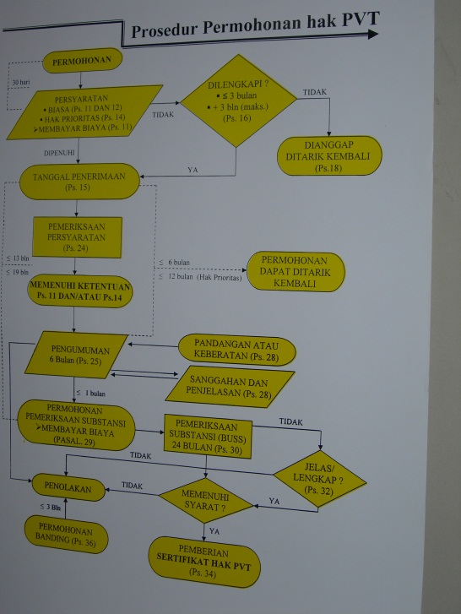
Practical implementation
Application procedure
Examination
  Non – technical
  Technical (DUS test)
Granting Plant Breeders’ Rights
DUS test = Test on Distinctness, Uniformity and Stability

Slide 81

Administrative infra structure
PVP office
  In Ministry of Agriculture
  In Patent office
  In Ministry of Justice
Duties
  Processing application
  Organising DUS test
  Reporting
  Granting Plant Breeder’s Rights

Slide 82

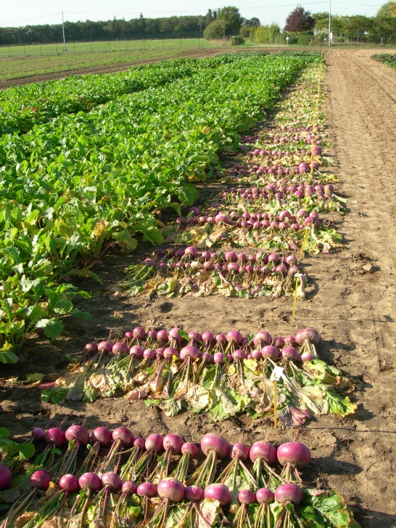
Technical examination - DUS testing
Official testing
  Decentralised
  Centralised
Breeder testing
Bilateral cooperation
Taking over reports

Slide 83
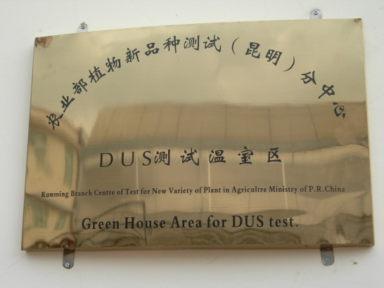
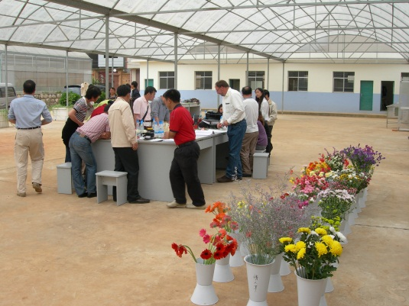
Official testing - decentralised
PVP office and separate DUS units (e.g. China)
  Test prepared in PVP Office (PVP Examiner)
  Test carried out by others (DUS tester)
  PVP Examiner ≠ DUS tester
Possible problems
  Poor communication between PVP examiner and DUS tester (miscommunication, delays etc)
  Expertise in different places

Slide 84
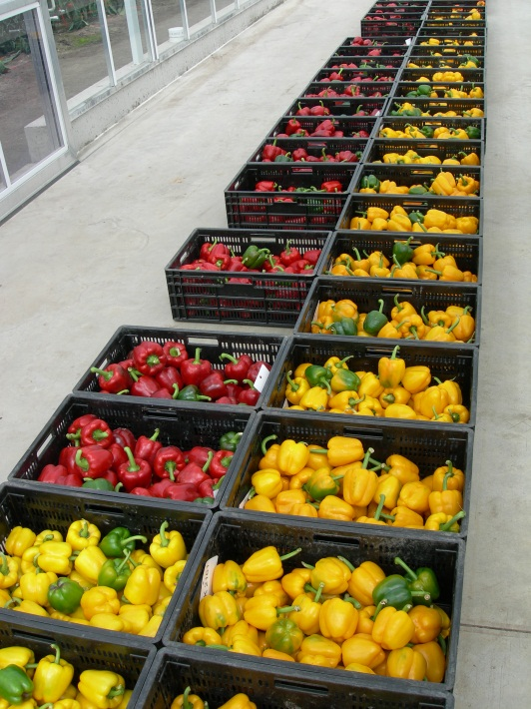
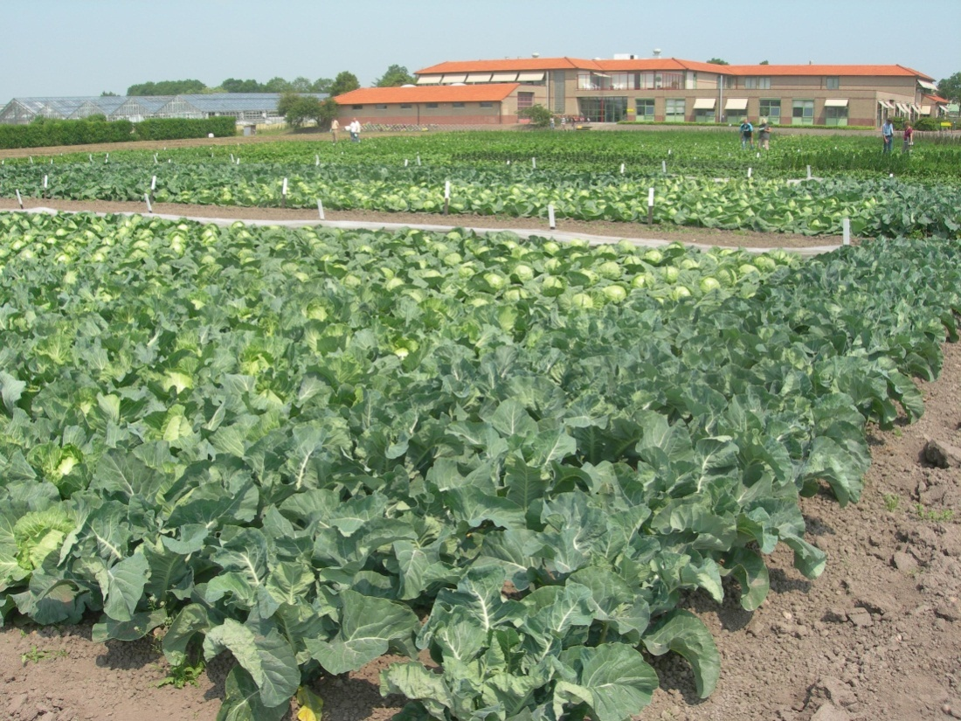
Official testing - centralised
From application to granting PVP in one organisation (e.g. Netherlands)
  PVP examiner = DUS tester
  Expertise in one organisation

Slide 85
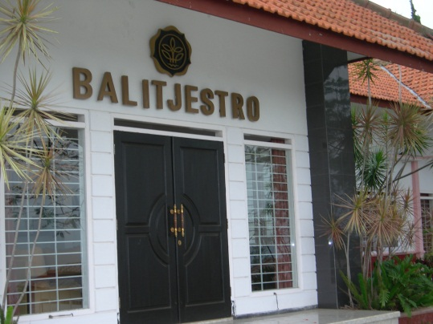
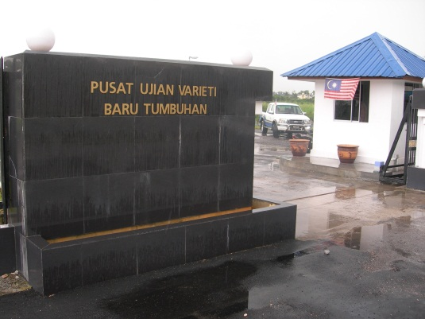
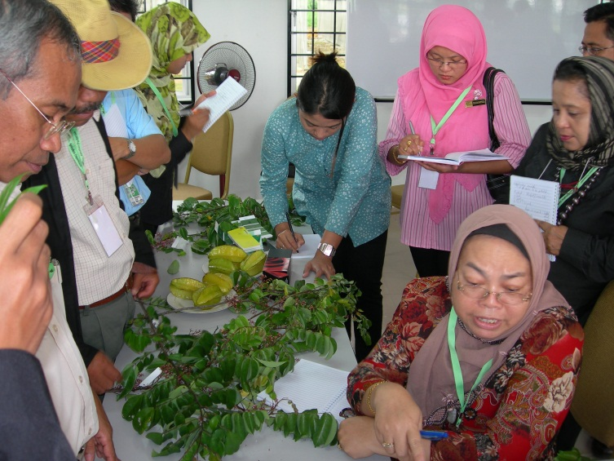
Choice of official DUS station
Where is expertise present?
In government research (breeding) institutes
Independence?
Comparable situation in the Netherlands forty years ago (IVT - Wageningen)
Only way to start

Slide 86
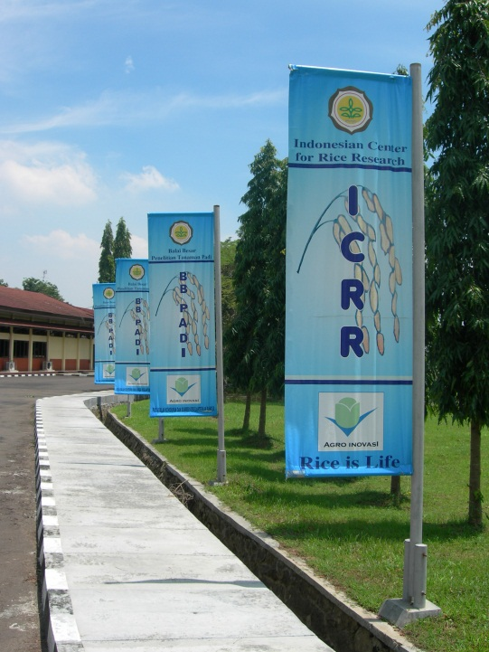

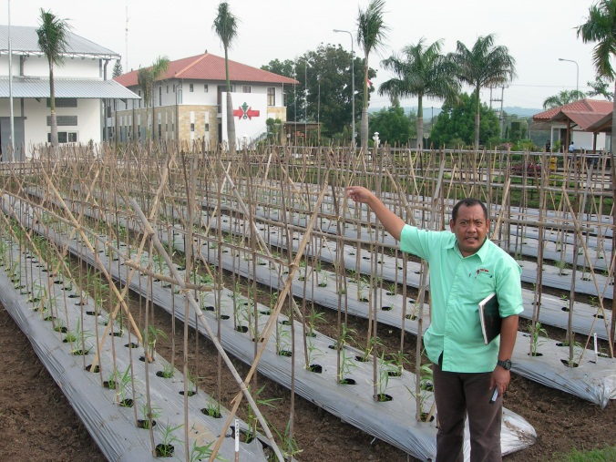
Breeder testing
Expertise present
  Independence
Role PVP examiner
  Designing test
  Measurements/observations
In emerging system most practical way
  Indonesia very common
  Vietnam – mentioned in PVP law

Slide 87
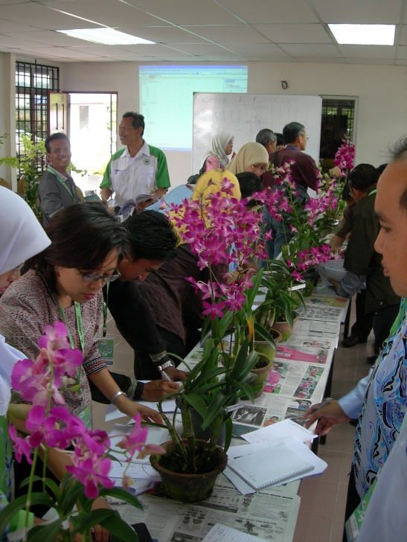

Bilateral cooperation
Small number of applications
Not sensible to build up expertise and allocate resources
Have variety tested in another country
  GENIE database
Sharing reference collections
  South East Asia
  East Asia PVP Forum
Join forces like EU system
  Discussions starting in Eastern Africa

Slide 88
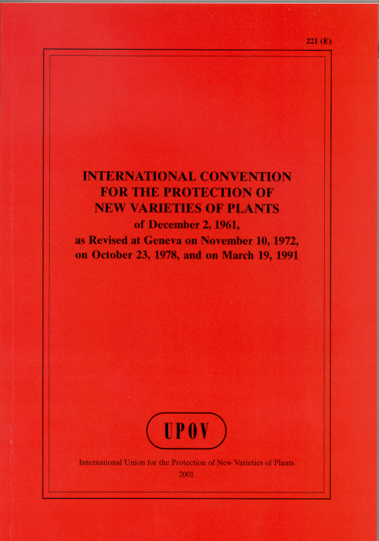
Crops to be protected
New UPOV member states
  Minimum of 15 plant genera and species
  After 10 years: all plant genera and species
  Example Vietnam
    UPOV member since 2006, started with 28 genera and species, in 2016 all genera and species
    System not ready for 2016
Example Indonesia (not an UPOV member)
    PVP law since 2000
    All species and genera to be protected

Slide 89
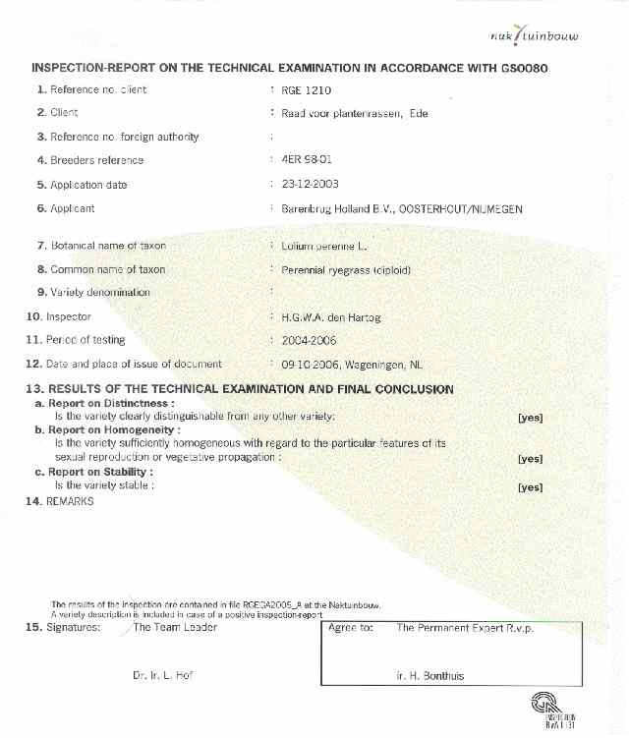
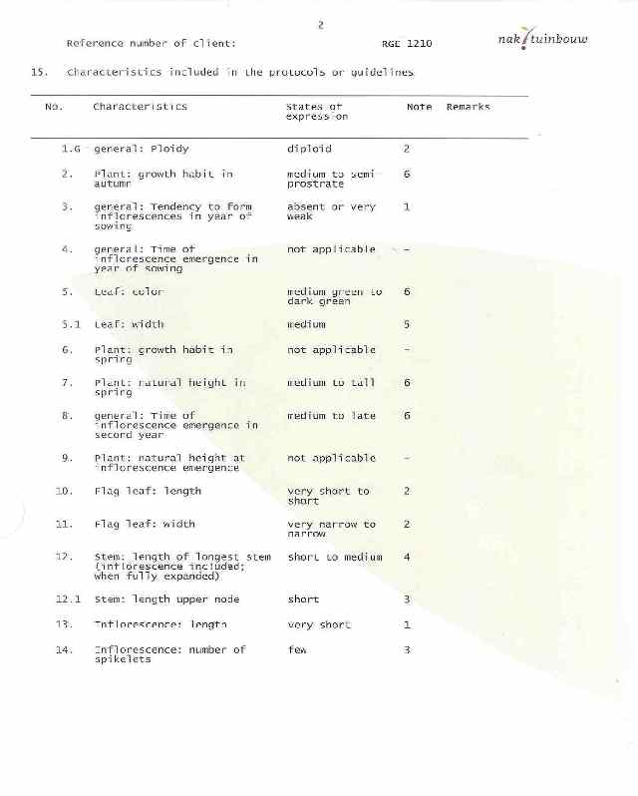
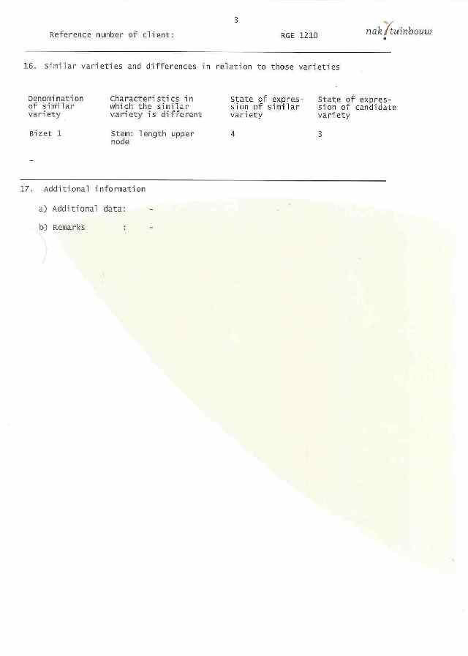
Taking over DUS reports (1)
Most efficient way of making use of UPOV harmonized system
  Country A buys DUS report from country B
  UPOV fixed fee of € 240
  Based on DUS report of country B, country A grants PVP
Some countries are too “proud” to buy
Some countries require Memorandum of Understanding or Technical Agreement with selling country e.g. Vietnam
  Not required

Slide 90
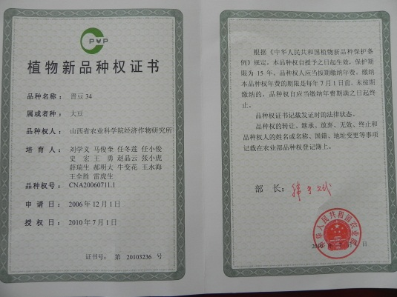
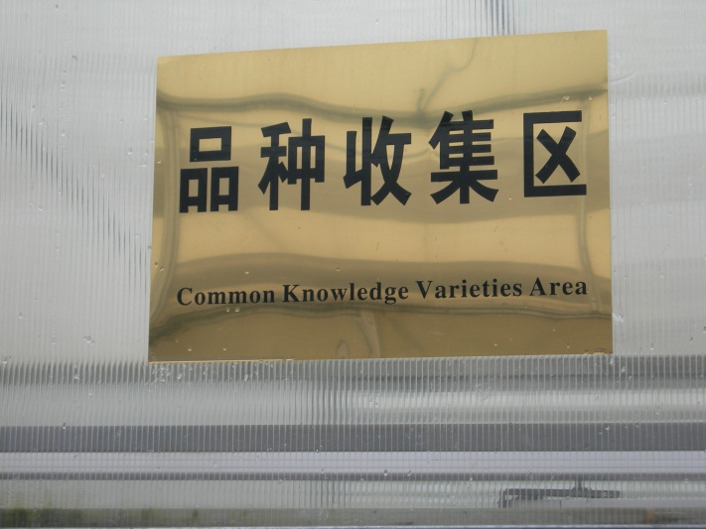
Taking over DUS reports (2)
Mostly asked question
  Has candidate variety in Dutch DUS test been compared with all varieties of common knowledge in that particular country?
Answer No
  In case of problems: nullification of Breeder’s Rights in later stage
Good communication required

Slide 91
Contents
Introduction
Introducing a Plant Variety Protection system
Practical implementation
Constraints in DUS testing
Concluding remarks

Slide 92
NL and new PVP countries- similarities
Follow same UPOV principles
  Even if not UPOV member (e.g. Indonesia)
UPOV Harmonised system
Taking over reports
Speak same PVP language
TG/1/3 General Introduction
“Associated” TGP Documents

Slide 93
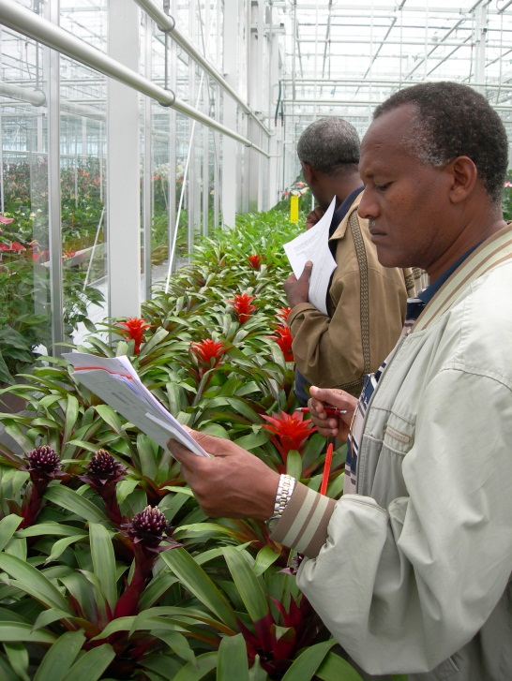
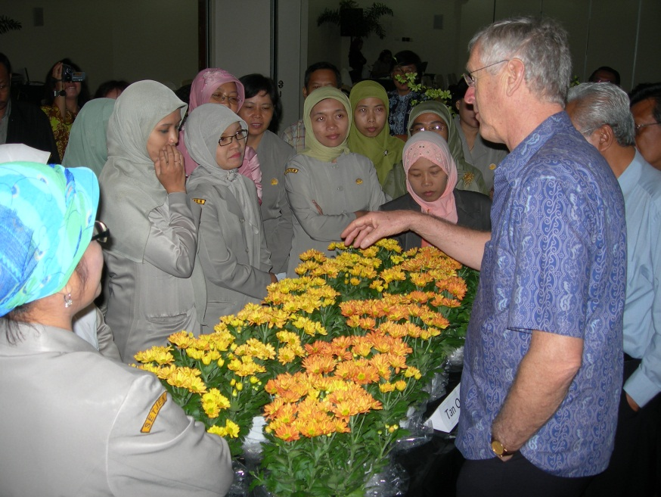
Constraints in execution DUS test
Variety collection
Database
Interpretation of characteristics
  Where and when to observe/measure on plant
Transforming data into notes
Use of statistics
Communication
Duration

Slide 94
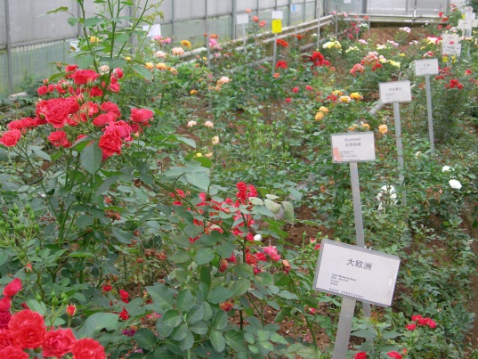
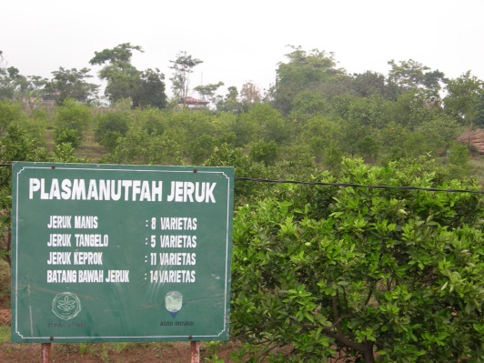
Variety collection
Problem: Absence of variety collection
How to build up collection?
Breeders hesitant to send in reference material
Applicant is requested to send comparison variety with candidate variety
  Sometimes impossible to obtain comparison variety from competitor
Collective action from Dutch rose breeders to help Chinese PVP with reference varieties

Slide 95
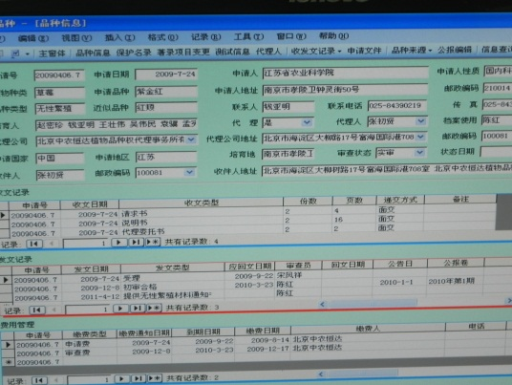
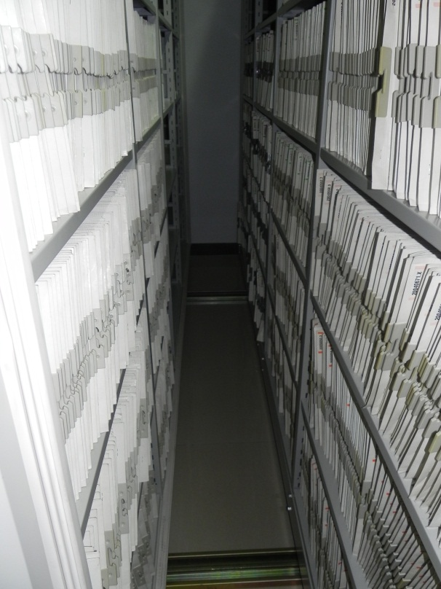
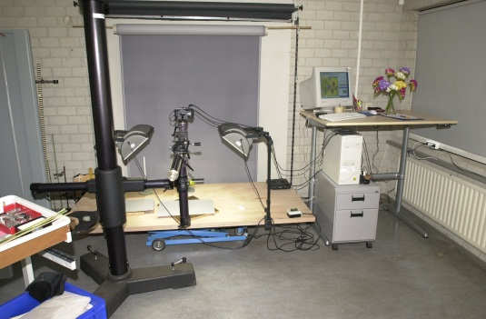
Database
Absence of database
  Numerical
  Photographic
  DNA
Sharing databases
between countries
Risk
  Combining data
  from different sources

Slide 96

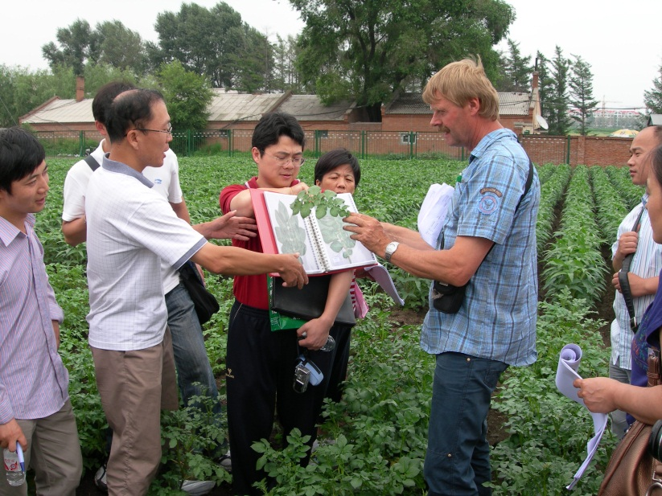
Interpretation of characteristics
What to observe/measure?
How to observe/measure?
Choice of example varieties
Guidelines do not give all answers
  Lengthy discussions
Solution: calibration books

Slide 97

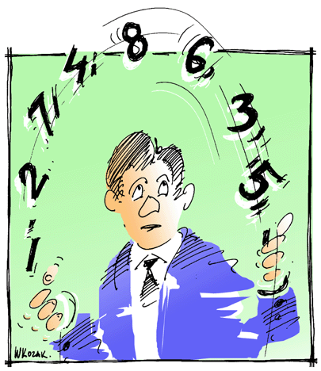
Transforming data into notes
Because of lack of expertise and insecurity DUS testers
  Many exact measurements are made
Problem
  Transformation data into notes for variety description

Slide 98
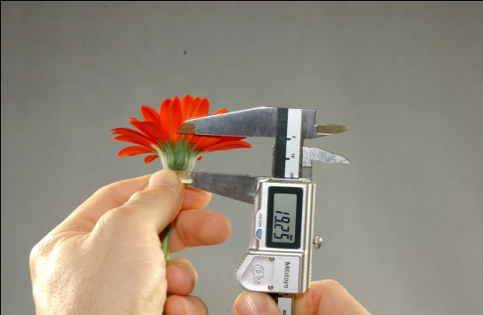

Superfluous use of statistics
Because of lack of expertise and insecurity DUS testers
  Many exact measurements are made
  Followed by statistical analysis while common sense could give answers
Not to be condemned
  Is a way to develop expertise

Slide 99

Communication
Open communication to applicant is essential
  Location, time of sowing, reporting problems, visiting trials, progress of application
Communication works both way
  For tester
  For applicant
Some countries are very restrictive in communication

Slide 100

Duration
Most annoying factor
Closely connected to poor communication
Often caused by bureaucracy

Slide 101
Contents
Introduction
Introducing a Plant Variety Protection system
Practical implementation
Constraints in DUS testing
Concluding remarks

Slide 102

Enforcement
Popular topic
Expectation: police force
Responsibility for the holder of the Plant Breeder’s Rights
Training judiciary
  Activity in Ethiopia PVP project

Slide 103

Impression
New countries make serious approaches
Eagerness to apply UPOV guidelines
Fear of making wrong decisions
  Therefore many exact measurements and statistics
  Causing delays
Often government institutes involved in DUS testing
  Low salaries, big turn over of personnel, loss of training input (e.g. Vietnam)
  Compare Kenya: KEPHIS independent institute, higher salaries, permanent staff

Slide 104



Comparison
Netherlands
  First breeders decree in 1941
  Development during 70 years
Emerging countries
  Just starting
New PVP countries deserve support
  Constructive criticism

Slide 105


