Slide 1
“Breeding Business”
A report on patents and plant breeder’s rights in the breeding industry
Niels Louwaars
Biopolicies specialist

Slide 2
Study for Ministers Verburg/vdHoeven
“The future of plant breeding in the light of developments in patent rights and plant breeder’s rights” December 2009
Study team:
  Dr. Anthony Arundel, UN-University (MERIT), Maastricht
  Prof. Dr. Hans Dons, Wageningen Universiteit
  Drs. Derek Eaton, LEI, Wageningen UR
  Dr. Ir. Niels Louwaars, CGN, Wageningen UR
  Dr. Annemiek Nelis, CSG, Nijmegen University
  Prof. Mr. Dr Geertrui Van Overwalle, TILT, Tilburg University
  Mr. Hans Raven, Intellectual Propery expert

Slide 3
Methodology
Trends
  Technology
  IP
  Breeding sector
  Society
Interviews with stakeholders
  Farmers, seed/breeding companies (field, vegetables, ornamentals), public research, biotech companies
Suggest actions for the Ministries if needed

Slide 4
Trends in Technology
Explosion of genomic information and opprotunities for MAS and transgenesis: Rod Snowdon
Other developments in breeding techniques
  Molecular mutagenesis
  Reverse breeding
  Cisgenesis
  Etc.

Slide 5
Trends in IP: swing of the pendulum
US-jurisprudence
  1980 Diamond vs Chakrabarty: GM-bacterium
  Ex Parte Hibberd 1985: plant variety
  Onco mouse: 1998
Europe: Directive 98/44/EU
Recent developments in the USA
  2005: re Fisher – utility problem in DNA sequence patents
  2009: re Kubin – lack of inventive step in gene coding for known protein
  2010: Ass. Molec.Pathology vs USPTO: Myriad Breast Cancer gene: novelty
Patent system adapts to technological and societal changes

Slide 6
Trends in the sector
Mid 1970s: modern plant biotechnology emerges
Late 1970s: first mergers and acquisitions in the seed industry
From 1980s: patenting of living organisms – genes – bio- technologies; strengthening of PBR

Slide 7
Rough sketch of business models
Fundamental
research
Applied
Biotech res.
Plant
breeding
Seed
production
Marketing
& sales
A _________________________________________
B ___________________________ _ _ _ _ _ _ _ _ _
C _____________________________________________________
D _______________
E ___________________________________ _ _ _ _ _ _ _ _ _ _ _ _ _ _ _ _ _ _ _ _ _ _ _

Slide 8
Concentration in the seed sector
1985 1996 2006
Company mUS$ Company mUS$ Company mUS$
Pioneer 735 Pioneer 1500 Monsanto 4028
Sandoz 290 Novartis 900 DuPont-Pioneer 2781
Dekalb 201 Limagrain 650 Syngenta 1743
UpjohnAsgrow 200 Advanta 460 Limagrain 1475
Limagrain 180 Seminis 375 KWS Saat 615
Global market 18,000 30,000 34,000
Top 4 (%) 8 12 30
Top 2 have over 50% of GM-patent applications in the USA

Slide 9
Patents play a role in this development
. . . . . next to globalisation and technological developments.
Patents
  Multiple claims
  Broad claims
  Reach-through claims
  Hardly any exemptions
  Large interpretation space
  Strategic uses leading to impenetrable patent landscapes
Compared to that, Breeder’s Rights seem lousy (business-wise) . . . .

Slide 10
. . . . . but:
Some companies may benefit from patents more than others
  Can control the patent thicket
  With their legal expertise they can outrun competitors
Practical breeding may benefit more from open innovation through PBR !!!
  Use genetic resources from competitors benefits all !!

Slide 11
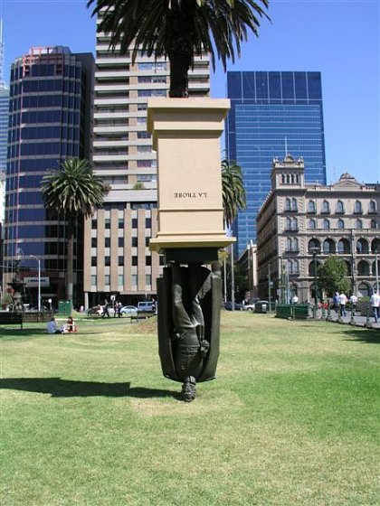
Life science patents has put breeding upside down
Concentration
in the seed industry
Worries about
innovation levels
Additional contributions
by the ‘enterprising
university’

Slide 12
IPRs as a tool to advance society
IPRs need to be:
  Accepted by society as a tool to facilitate innovation
  Adequate and fair balance
  Trick resistant
If IPRs in the life sciences lead to monopolies, concentration, reduced incentives for innovation . .
  society will suffer from reduced innovation levels
  companies loose their license to produce
  And in breeding-related IPRs:
  Global food security may be at risk

Slide 13
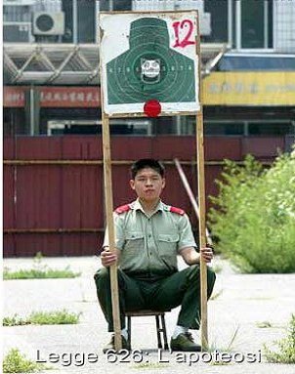
Some have different perspectives of risk!!

Slide 14
Suggestions by the team:
IF . . . .
  Breeding should continue to be a main tool towards food security and sustainable agriculture;
  Access to genetic resources is considered important
  Innovation strength of the sector be preserves/increased
  Diversity of companies is key for healthy competition
  The Dutch breeding sector is to safeguard its position
  A decent profit margin should be made possible, and
  IPRs are considered to be one of the keys, then . . . .

Slide 15
Then . . . .
Avoid strategic use of the patent system
  Role of the sector itself
  Should come up with solutions in short period
Radically improve the operation of the patent offices
  Increase patent quality
  Do not grant applications that are not inventive, not new, and that are not described clearly enough
  (we couldn’t advise on the operation of the courts)
Change patent law (in the Netherlands/ EU)
  Introduce a full breeder’s exemption, or
  Exclude plants from patentability
  (Considered the French/German solution, but found insufficient)

Slide 16
In addition:
Look into competition law
Look into public research policies
Look into development policies (trade negotiations)
Look into genetic resources policies
Bottom line: always go back to the original purpose of IPRs:
  balance the interest of the inventor and society.
  to stimulate innovation in this important sector

Slide 17
Letter to Parliament (April 19, 2010)
Confirm that patents and PBR seems out of balance; access to genetic resources needs to be supported
French/German solution could be pursued but does not solve the problem
MoA to discuss with EC in relation to CPVO-evaluation
MoE to discuss with EC; suggest a review of Biotech-Directive
Further support to the ‘raising the bar’ process at EPO
Find ways to reduce uncertainty about patents with the Board for Plant Varieties
Invite the sector to develop a FRAND code-of–conduct
Support public research; int’l access to PGR
Put the issue on the agenda in Europe and beyond

Slide 18
Follow-up
Plantum NL started debates in the sector to create a solution
The Ministries (now EL&I) investigated the legal implications of the various options (ref national, EU and WTO rules)
The issue came back in Parliament last week.
  Further action was confirmed by Mr Bleeker.

Slide 19
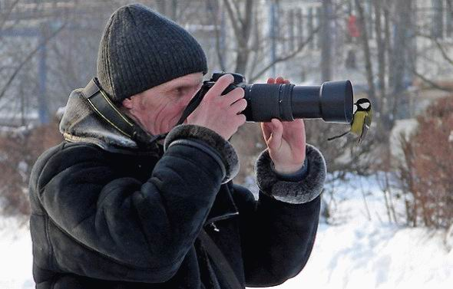
Point of view is important to finding solutions to a problem!

Slide 20
Vision on intellectual property protection in plant sciences by the plant breeding industry
- BSHS, 26 May Venlo, Anke van den Hurk-

Slide 21
Need for solution to the Interface plant breeders’ rights and patents
Plantum NL the association of the plant breeding sector
Plant breeding and the need for intellectual property
Plant breeding sector and its’ position with regard to intellectual property
Political developments with regard to the interface between plant breeders’ rights and patents

Slide 22
Plantum NL
Dutch association for companies active in breeding, tissue culture, production and trade of seeds and young plants, agriculture, vegetables and ornamentals
> 400 members

Slide 23
Plant breeding and need for IP
Plant breeding for the development of new varieties adapted to the needs of grower, producer and consumer needs
IP is developed and useful to:
Stimulate innovation
Have a contract with the society for a temporal monopoly, while the invention is made available to society
Balance between interest society and inventor

Slide 24
Origin Plant Variety Protection
US Plant Patent Act (1930)
No explicit breeders’ exemption, but the right is limited to asexual propagation
1940’s beginning of first PBR legislation in Europe
First Treaty on Plant Breeders Rights:
UPOV Convention 1961

Slide 25
Origin Plant Variety Protection
Deliberate choice for a specific Intellectual Property Right for plant varieties instead of protection by patents
  Self reproductive material
  Different ways of multiplication/ appearance
  Influence of environment
  Paper examination not sufficient

Slide 26
Breeders’ exemption UPOV 1961
Art. 5 sub 3
“Authorization by the breeder or his successor in title shall not be required either for the utilization of the new variety as an initial source of variation for the purpose of creating other new varieties or for the marketing of such varieties.”

Slide 27
Patent legislation in Europe
1998: EU Directive for biotech inventions
Claims on biological material also after propagation and multiplication
Directive was created in reaction to developments on the field of Genetic Modification
Implementation in the different national patent laws:
No connection with GMO

Slide 28
Comparison patents and plant breeders’ rights
Plant breeders’ rights
Plant varieties
Monopoly
Free for private use
Free for research
Farmers’ privilige
Breeders’ exemption
Patents
Everything (except plant varieties and essentially biological processes)
Monopoly
Free for private use
Research exemption
Farmers’ privilige
Notes:
Not patentable:
- plant varieties
- essentially biological processes
BUT
patents on plants are possible as long as not restricted to one variety as such
Is a breeding method essentially biological if it comprises “a technical step”?
Patent on a trait (GM or non-GM) covers all varieties containing that trait
Patented method covers all varieties resulting from that method
Varieties falling under the scope of a patent can not be used by others for further breeding

Slide 29
Breeders’ exemption
Breeders’ rights do not extend to:
acts done for the purpose of breeding other varieties and, for the purpose of exploiting these new varieties provided the new variety is not a variety essentially derived from another protected variety (the initial variety).
Notes:
The breeder's right does not extend to
(i) acts done privately and for non-commercial purposes,
This exception means that, for example, subsistence farming is excluded from the scope of the breeder's right
(ii) acts done for experimental purposes and
(iii) acts done for the purpose of breeding other varieties and, for the purpose of exploiting these new varieties provided the new variety is not a variety essentially derived from another protected variety (the initial variety).
This exception, for the purpose of breeding other varieties, is a fundamental aspect of the UPOV system of plant variety protection and is known as the "breeder's exemption". It recognizes that real progress in breeding-which, for the benefit of society, must be the goal of intellectual property rights in this field-relies on access to the latest improvements and new variation. Access is needed to all breeding materials in the form of modern varieties, as well as landraces and wild species, to achieve the greatest progress and is only possible if protected varieties are available for breeding.
The breeder's exemption optimizes variety improvement by ensuring that germplasm sources remain accessible to all the community of breeders. However, it also helps to ensure that the genetic basis for plant improvement is broadened and is actively conserved, thereby ensuring an overall approach to plant breeding which is sustainable and productive in the long term. In short, it is an essential aspect of an effective system of plant variety protection system which has the aim of encouraging the development of new varieties of plants, for the benefit of society.

Slide 30
Research exemption
The Biotech directive 98/44/EG does not have a specific provision on the research exemption
National decision on implementation research exemption
In general this means:
  Exception for scientific purposes without commercial perspective
  Research on the invention but not with the invention

Slide 31
Scope patent
Plant varieties excluded
Essentially biological processes excluded
Patent on plant characteristic stretches to all plant varieties that include the characteristic
Patent on research method comprise all plant varieties that are developed with the method
Result: Not all plant varieties are freely available for further breeding

Slide 32
Patents in the breeding sector
Increase of patents in the plant breeding world
Bad patents
Concentration of companies
Greater difference between multinationals and small and medium sized enterprises
Limitations to biological material for plant breeding
Difficulties with licenses
Long-term insecurity

Slide 33
Position breeding industry so far
ISF + ESA:
Breeding should be free until the moment of commercialisation
The commercial use of a new plant variety no longer expressing the function of patented elements should be free
The commercial use of a plant variety expressing the function of patented elements requires a license

Slide 34
Different opinions emerge
Croplife International
To further strengthen protection plant varieties
To make position ISF more strict
  Limit breeding varieties with patented trait
  Extend duration patent
ESA/ISF
Discussions on their positions
Plantum NL
Revision of position
Notes:
Extend time to commercialization

Slide 35
Plantum NL position (May 2009)
Biological material protected by patent rights should be freely available for the development of new varieties.
The use and exploitation of these new varieties should be free, in line with the ‘breeders’ exemption’ of the UPOV Convention.
The aforementioned free availability, use and exploitation should not be allowed to be obstructed in any way, either directly or indirectly, by patent rights.

Slide 36
Discussing new positions
ISF
- IPC is working on a revision of the View on IP
- Goal: submit to the members at the Rio de Janeiro congress in 2012
ESA
- CIPR is working on a revision of the IP position paper
- Goal: submit to the members at the annual meeting in Hungary in Ocotber 2011
Outcome: still very unsure

Slide 37
Political developments
Dutch government started discussion on the effects of patents on plant breeding
  Report The future of plant breeding in the light of patent rights and plant breeders’ rights 2009
    Adapt legislation
      1st step limited breeders’ exemption
      2nd step full breeders’ exemption in biotech directive
    Improve quality of patents
    Avoid strategic use/abuse
    Develop sectoral solutions
Notes:
minister Aigner wants to make European rules regarding biological patents more precise. Although the agriculture minister does not oppose the patenting of new breeding procedures, she argues that the resulting whole organisms should not be patentable.

Slide 38
Political developments
Netherlands; Start of sector discussion
Study the legal possibility for the breeders’ exemption in patent legislation
Request for alternative solutions
Debate in the parliament on 18 May
  Broad support for breeders’ exemption in patent legislation
  State Secretary Bleeker will strive for breeders’ exemption in patent legislation
Germany; minister Aigner has spoken out against the patenting of varieties of livestock and plants June 2010
Notes:
minister Aigner wants to make European rules regarding biological patents more precise. Although the agriculture minister does not oppose the patenting of new breeding procedures, she argues that the resulting whole organisms should not be patentable.

Slide 39
Solution for the interface Plant Breeders’ Rights and patents
Plantum NL is in favour of strong IP rights for one’s own varieties
But others should be able to use all characteristics in making new varieties
We strive for a full breeders’ exemption (breeding & commercialisation) in patent legislation
= boost for innovation

Slide 40
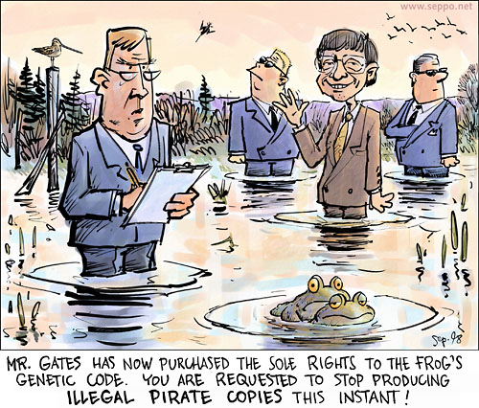
Thank you for your attention!

Slide 41
The importance of IP for a company
like Enza Zaden
Enza Zaden Research & Development B.V.
J.J.M. Lambalk
Intellectual property rights in horticulture
BeNeLux SHS / Venlo / May 26th 2011
J.J.M. Lambalk | BeNeLux SHS / Venlo / 26052011

Slide 42
Enza Zaden, who we are:
• Founded in 1938
• Head office in Enkhuizen, The Netherlands
• Independent / family-owned
• Breeding in vegetables only: 20 species
• 1193 employees worldwide / 576 employees in R&D (01/01/2010)
• 18 R&D subsidiaries worldwide
• No. 8 within world top 10 vegetable seed companies
• 2010: > € 160 mio net sales /
total investments R&D: 28% = € 45 mio per year
J.J.M. Lambalk | BeNeLux SHS / Venlo / 26052011
Notes:
Klik met de muis: - op HOOFDSTUK/TITEL om terug te keren naar de inhoudspagina!

Slide 43
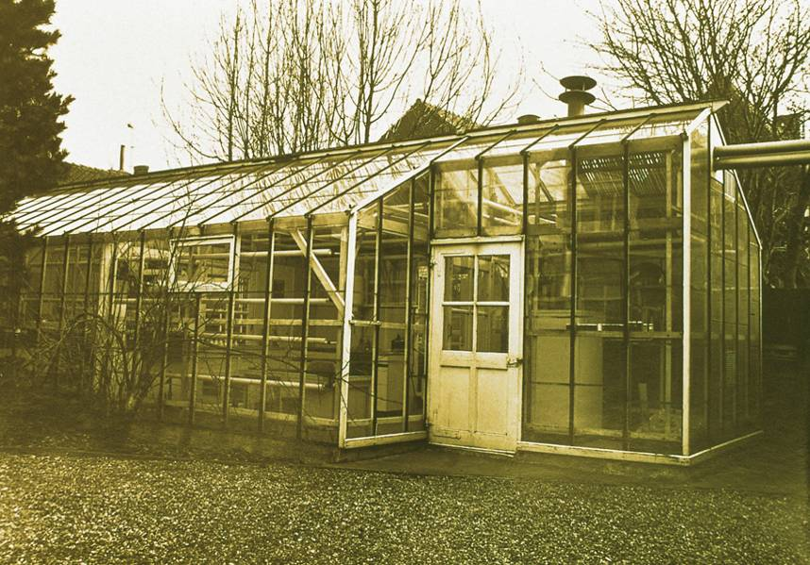
Enza first greenhouse / 60 m² in 1959

Slide 44
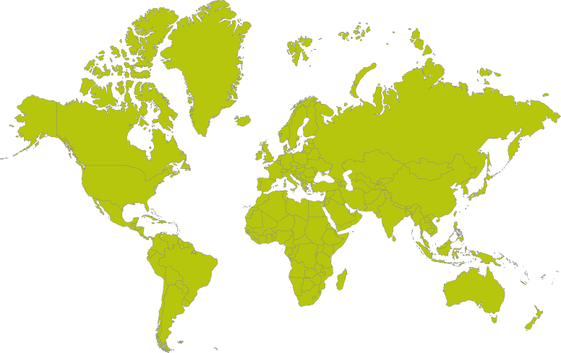




But now spanning the globe
Research & Development
Commercial
Distributors
Others
J.J.M. Lambalk | BeNeLux SHS / Venlo / 26052011

Slide 45
R&D breeding stations
Breeding Stations Europe
NL Enkhuizen
SP Almería
SP Albujon (Murcia)
FR Allonnes
FR Chateaurenard
GER Dannstadt
IT Tarquinia
TUR Antalya
Breeding Stations America’s
USA San Juan Bautista (CA)
USA Bradenton (FL)
MEX Culiacan
BR Holambra
Breeding Stations Oceania
AUS Narromine
NZ Pukekohe
Breeding Stations Asia
IND Purwakarta
CH Beijing
CH Guangdong
J.J.M. Lambalk | BeNeLux SHS / Venlo / 26052011

Slide 46
Growth and development Enza Zaden
Net sales

Slide 47
Growth and development Enza Zaden
input Frank Acda
J.J.M. Lambalk | BeNeLux SHS / Venlo / 26052011

Slide 48
Growth and development Enza Zaden

Slide 49
The impact of technology within our company
1987: start of ‘biotechnology lab’ within Enza Zaden
2011: 89 employees in research
1989: Keygene NV, Wageningen
2011: 130 employees
J.J.M. Lambalk | BeNeLux SHS / Venlo / 26052011

Slide 50
Breeding supporting (bio)technologies
• Cell technologies
• Biochemistry
• (Molecular) phytopathology
• Molecular biology: genomics and genetics
J.J.M. Lambalk | BeNeLux SHS / Venlo / 26052011

Slide 51
Another impact of technology within our company:
growing importance of intellectual property rights
J.J.M. Lambalk | BeNeLux SHS / Venlo / 26052011

Slide 52
Plant breeders rights:
• EU
• Dutch
J.J.M. Lambalk | BeNeLux SHS / Venlo / 26052011

Slide 53
Patent:
J.J.M. Lambalk | BeNeLux SHS / Venlo / 26052011
Notes:
53
8. Breeding is craftsmanship; it requires a lot of experience, knowledge and skills to design the crosses and to make appropriate selections.

Slide 54
Difference between PBR and patents
  Plant breeders rights:
    Reward for hard work / craftmanship
    Plant varieties as a whole
    Use is allowed (breeders exemption)
    Scope of protection is limited to plant variety
J.J.M. Lambalk | BeNeLux SHS / Venlo / 26052011

Slide 55
Difference between PBR and patents
  Plant breeders rights:
    Reward for hard work
    Plant varieties as a whole
    Third party use is allowed
    (breeders exemption)
    Scope of protection is limited to plant variety
  Patents:
    Reward for a technical solution to a problem
    Products / methods / use (specific trait or genetic locus)
    Use is not allowed (discussion)
    Thus: broader scope of protection process + products derived thereof (=plant varieties)
J.J.M. Lambalk | BeNeLux SHS / Venlo / 26052011

Slide 56
IP portfolio Enza Zaden
• EU breeders rights (2008-2010): 132
• USA utility patent : 7
• Patents - patent applications : 11
J.J.M. Lambalk | BeNeLux SHS / Venlo / 26052011
Notes:
11. Its about speed; because it is a hell of a job to have all these important characters stably combined.
There is always something which makes the result not exactly as what you aimed for.

Slide 57
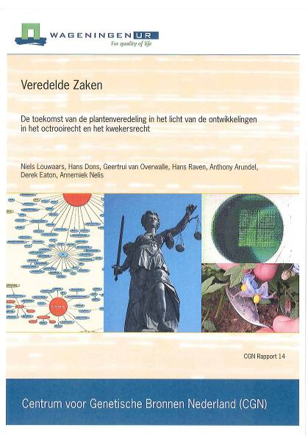
Current NL discussion on
‘patents and plant breeders rights’
J.J.M. Lambalk | BeNeLux SHS / Venlo / 26052011

Slide 58
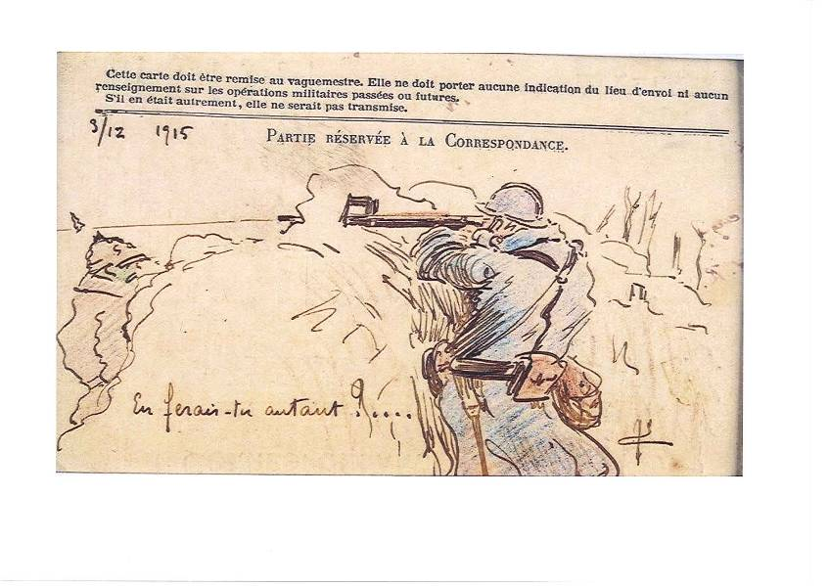
Trenchwar: ‘big against small?’
J.J.M. Lambalk | BeNeLux SHS / Venlo / 26052011

Slide 59
Opinion Enza Zaden only!
J.J.M. Lambalk | BeNeLux SHS / Venlo / 26052011

Slide 60
Is there a best solution for everybody?!
• Focus on similarities instead of differences
• What can be changed (quickly)?
• Mutual agreements
J.J.M. Lambalk | BeNeLux SHS / Venlo / 26052011

Slide 61
What can be changed (quickly)?
• Patentability of native- and non-native traits?
• The only IP possibility to protect plant
varieties is PBR?
J.J.M. Lambalk | BeNeLux SHS / Venlo / 26052011

Slide 62
Legal framework IP patents / plant varieties:
EC Directive 98/44
J.J.M. Lambalk | BeNeLux SHS / Venlo / 26052011

Slide 63
Biological material can be patented
  EC Directive 98/44/EC:
Article 3
For the purposes of this Directive, inventions which are new, which involve an inventive step and which are susceptible of industrial application shall be patentable even if they concern a product consisting of or containing biological material or a process by means of which biological material is produced, processed or used.
Biological material which is isolated from its natural environment or produced by means of a technical process may be the subject of an invention even if it previously occurred in nature.
J.J.M. Lambalk | BeNeLux SHS / Venlo / 26052011

Slide 64
But not everything can be patented
  EC Directive 98/44/EC:
Article 4
1. The following shall not be patentable:
(a) plant and animal varieties;
(b) essentially biological processes for the production of plants or animals.
2. Inventions which concern plants or animals shall be patentable if the technical feasibility of the invention is not confined to a particular plant or animal variety.
Implemented in EU patent law (art 53b EPC) and Dutch patent act (artt. 2b, 3c, 3d, 53a ROW1995)
J.J.M. Lambalk | BeNeLux SHS / Venlo / 26052011
Notes:
There are 2 type of tools which I would like to highlight: the 1st one deals with the production of homozygous lines which is key in hybrid breeding.
The classical way asserts from a heterozygous parent which, after one generation of selfing, results in 50% of the loci to be in homozygous configuration. After the 2nd generation, again half of the remaining 50% will be in homozygous state -> in total 75% ETC.
That’s why it takes 6 – 9 years before homozygous lines are obtained.
By use of tissue culture … so called unmature egg or pollen cell can be used develop into a plant without cross fertilization!
The start is at the flower stage -> anthers -> embryo formation -> chromosome doubling -> plant.
Creating homozygous parental lines can take a couple of years when it is performed via the classical way. In the “Biotech-Way” it takes a couple of months.

Slide 65
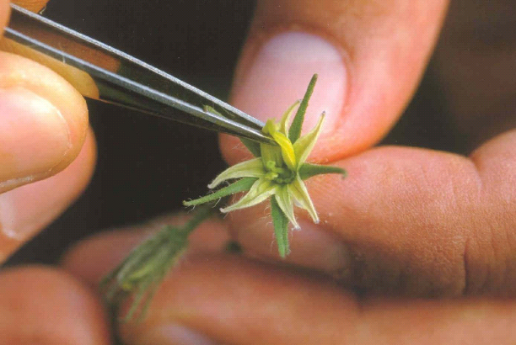
Essentially biological processes …
Can be thought of as those processes traditionally done by breeders.
Article 2(1) UPOV Convention 1961:
simultaneous protection for the same botanical genus or species by plant breeders' right and patent not allowed.
Rule 26(5) EPC (2000):
“A process is essentially biological if it consists entirely of natural phenomena such as crossing and selection“.
J.J.M. Lambalk | BeNeLux SHS / Venlo / 26052011

Slide 66
Essentially biological processes …
Recent ruling from the EPO (enlarged board of appeal) (broccoli & tomato case)
G2/07 & G1/08:
“... process ... for the production of plants ... consists of the steps of crossing ... and .. selection ...
... is excluded from patentability within the meaning of art 53b EPC ...”
... does not escape the exclusion from patentability because it contains a step of technical nature ... “ (like DNA markers)
J.J.M. Lambalk | BeNeLux SHS / Venlo / 26052011

Slide 67
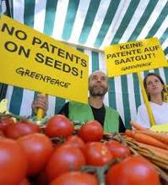
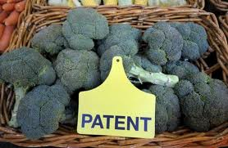
Consequences
  G2/07 & G1/08:
    Is about breeding methods
    Corresponding products can still be patented
J.J.M. Lambalk | BeNeLux SHS / Venlo / 26052011

Slide 68
Again… what can be changed (quickly)?
• Patentability of native- and non-native traits?
• The only IP possibility to protect plant
varieties is PBR?
ANSWER = NO
J.J.M. Lambalk | BeNeLux SHS / Venlo / 26052011

Slide 69
(further) restrictions/limitations in
patentlaw in relation to plants/varieties
desirable developments for our breeding
Industry?
Opinion Enza Zaden = No!
J.J.M. Lambalk | BeNeLux SHS / Venlo / 26052011

Slide 70
Our motivation
• No restrictions on patentability on true inventions
(in line with EC98/44)
• Inventors deserve a proper reward for their IP =
inventions
• Patents stimulate innovative research both private
and non-private sector
J.J.M. Lambalk | BeNeLux SHS / Venlo / 26052011

Slide 71

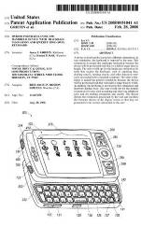

Patent = contract between inventor
and society
  Exclusivity:
    Limited time span (20 yrs)
    Limited area (eg EP,US,NL)
  Condition:
    PUBLICATION!
J.J.M. Lambalk | BeNeLux SHS / Venlo / 26052011

Slide 72
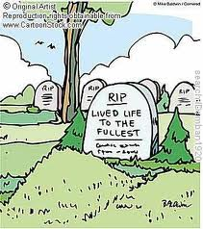
What happens if inventions are not
published?
J.J.M. Lambalk | BeNeLux SHS / Venlo / 26052011

Slide 73
Specific adaptation NL patent law
(in relation to ‘broad breeders exemption’)
I
GOOD FOR NL?
• Business opportunities green biotech??
• Ambitions bio based economy??
• High quality scientific network NL??
J.J.M. Lambalk | BeNeLux SHS / Venlo / 26052011

Slide 74
Negative impact ‘broad breeders exemption’ on
green high tech research programs.
• IP on technology
• Varieties resulting from technology: PBR only
• ROI in lead period?
Example:
Phytophtora infestans-R in Solanaceous crops
J.J.M. Lambalk | BeNeLux SHS / Venlo / 26052011

Slide 75
Critical remarks on patents in our
breeding industry
• Scope of protection too broad
• Unbalanced power
• Monopolies / abuse of dominant position
• Limitations access to (breeding) material
• Only access on very unfavourable conditions
• Lack of clearity: many patentholders on same
subject
J.J.M. Lambalk | BeNeLux SHS / Venlo / 26052011

Slide 76
Scope of protection too broad?
Many patentholders on same subject
• EPO examination = EC 98/44
• G2/07 & G1/08
J.J.M. Lambalk | BeNeLux SHS / Venlo / 26052011

Slide 77
What can be changed?
All other aspects can be solved by:
Clear appointments on ‘access’
Good ongoing discussions in Working Group ‘Industry solutions to the interface PBR and patents’
J.J.M. Lambalk | BeNeLux SHS / Venlo / 26052011

Slide 78
Access to (breeding) material originating
from IP protected proces
Opinion
What Meaning Enza Zaden
restricted use allowed in
breeders breeding proces / yes
exemption license necessary
in case of
commercialisation
broad free use during
breeders breeding proces/ no
exemption no license necessary
in case of
commercialisation
= no patent claims
on varieties plant
J.J.M. Lambalk | BeNeLux SHS / Venlo / 26052011

Slide 79
Most important
Clear agreements on access to IP based
upon FRAND Principle (Fair, Reasonable
And Non-Discriminatory)
J.J.M. Lambalk | BeNeLux SHS / Venlo / 26052011

Slide 80
Conclusion
‘Broad breeders exemption’ may be good for:
• Low-tech breeding companies
Far from good for:
• Innovative breeding companies investing a lot of
money in new technology development
• National- and international scientific community
working on (basic) plant research

Slide 81
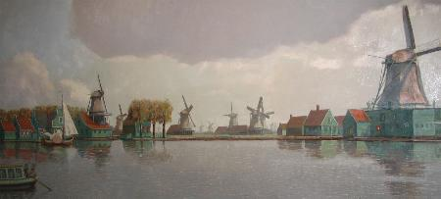
Going back in time ??
Dutch industry mid 19th century | Zaanse Schans - 1850
DISCUSSION
J.J.M. Lambalk | BeNeLux SHS / Venlo / 26052011

